Slide 1
Unit 01 Overview of computing paradigm

Slide 2
Background
Traditional computing primarily relied on physical infrastructure located on-premises to store, manage, and process data.
This setup involved dedicated hardware, servers, and software maintained within an organization's premises, requiring significant investment in infrastructure, maintenance, and skilled personnel.
Cloud technology introduced a revolutionary approach by leveraging the internet to deliver computing services remotely.
It evolved to provide scalable and flexible resources on-demand, allowing users to access a shared pool of configurable resources like servers, storage, databases, and applications.

Slide 3
Background
Let us see some the stats of Cloud Computing and its usage as per Gartner’s and Statista reports:
As on 2023, the cloud applications market is worth over $150 billion.
200 ZB of data will be stored in the cloud by 2025.
60% of the world’s corporate data is stored in the cloud.
Cloud data centers account for 3% of the world’s energy consumption.
Cloud infrastructure services generate $178 billion per year in revenue.
90% of large enterprises have adopted a multi-cloud infrastructure.
Enterprises use an average of 2.6 public and 2.7 private clouds.
Public Cloud Services spending could reach almost $600 billion in 2023.
Almost $200 billion is the forecast to be spent on SaaS in 2023.
Cloud IaaS generate $178 billion per year in revenue.

Slide 4
Background
Traditional computing refers to the conventional model of computing that relies on localized hardware and software installed and operated on-premises, typically within an organization's own data centers or physical infrastructure.
In traditional computing:
On-Premises Infrastructure
Fixed Capacity
Limited Accessibility
Capital Expenditure
Responsibility for Security

Slide 5
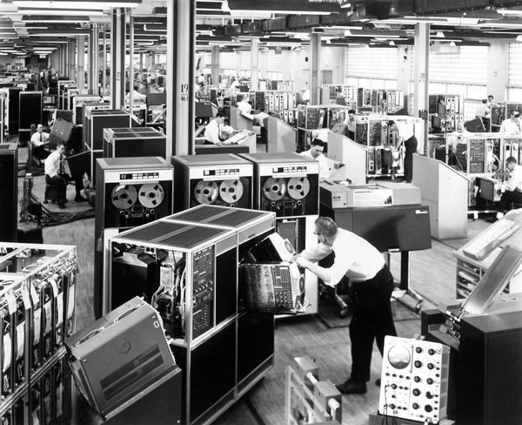
HISTORY OF CLOUD COMPUTING
Organizations initially adopted large mainframe computers in the 1950s, but the high cost prevented widespread individual use.

Slide 6
HISTORY OF CLOUD COMPUTING
To optimize the expensive processing capacity of central mainframes, time sharing emerged in the late 1950s and early 1960s.
This approach enabled users to access multiple computing instances concurrently, boosting processing power and minimizing downtime, laying the groundwork for today's cloud computing.

Slide 7
HISTORY OF CLOUD COMPUTING
In 1969, computer scientist J.C.R. Licklider pioneered the concept of distributing computing resources globally, contributing to the development of the Advanced Research Projects Agency Network (ARPANET), a precursor to the internet.
Licklider aimed to establish worldwide computer connectivity for users to access software and data from any location.
The advent of virtual machines (VMs) in the 1970s revolutionized computing by enabling multiple computer systems to operate within a single physical setup.
This innovation catalyzed the notion of hybridization, profoundly impacting the evolution of cloud technology.

Slide 8
HISTORY OF CLOUD COMPUTING
Throughout the 1970s and 1980s, Apple, Microsoft, and IBM developed technologies that enhanced the cloud environment, promoting the use of cloud servers and server hosting.
In 1999, Salesforce made history by offering the first online business applications, revolutionizing the traditional software model.
Salesforce provided businesses, regardless of size, the ability to expand and access applications online, eliminating the need for multiple software licenses and physical installations.

Slide 9
HISTORY OF CLOUD COMPUTING
Amazon introduced Amazon Web Services (AWS) in 2006, marking a milestone by providing cloud-based storage and computing services.
Subsequently, major technology companies like Google and Microsoft introduced their own suite of related solutions and offerings in the cloud computing space.

Slide 10
HISTORY OF CLOUD COMPUTING

Slide 11
DEFINITION OF CLOUD COMPUTING
The National Institute of Standards and Technology (NIST) characterizes cloud computing as
“Cloud computing a pay-per-use model for enabling available, convenient, on-demand network access to a shared pool of configurable computing resources (e.g. networks, servers, storage, applications, services) that can be rapidly provisioned and released with minimal management effort or service provider interaction.”
Cloud as the “data center hardware and software that provide services.”

Slide 12
DEFINITION OF CLOUD COMPUTING

Slide 13
DEFINITION OF CLOUD COMPUTING

Slide 14
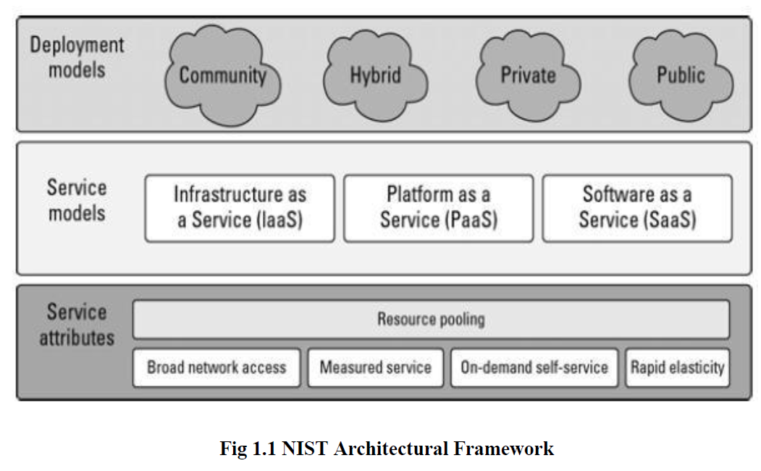
DEFINITION OF CLOUD COMPUTING

Slide 15
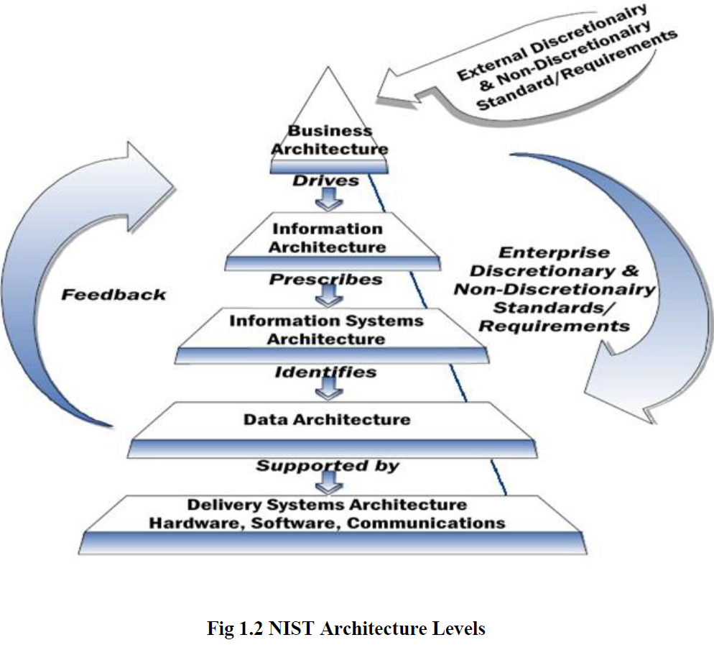
DEFINITION OF CLOUD COMPUTING

Slide 16
EVOLUTION OF CLOUD COMPUTING
Hardware (virtualization, multi-core chips)
Internet technologies (Web services, service-oriented architectures, Web 2.0)
Distributed computing (clusters, grids)
Systems management (autonomic computing, data center automation)

Slide 17
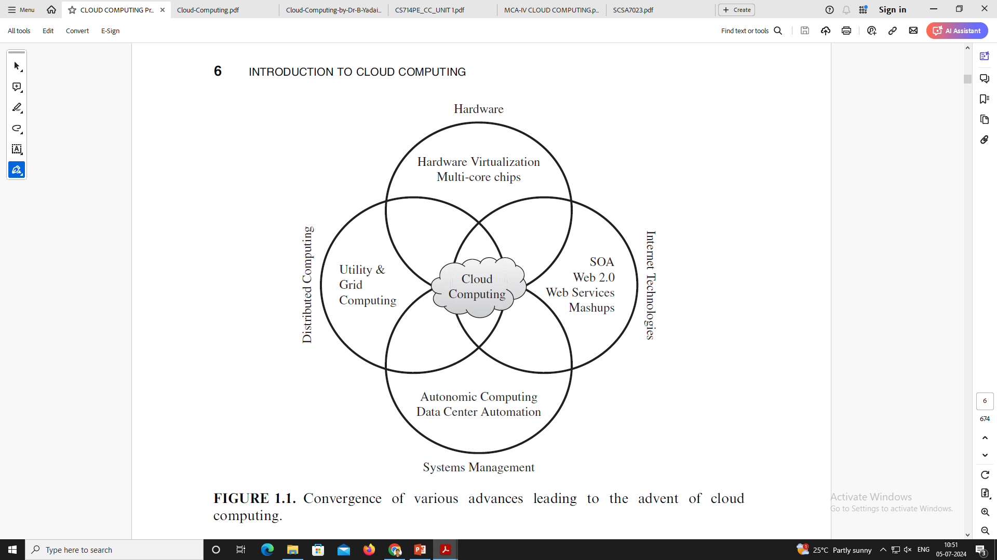
EVOLUTION OF CLOUD COMPUTING

Slide 18
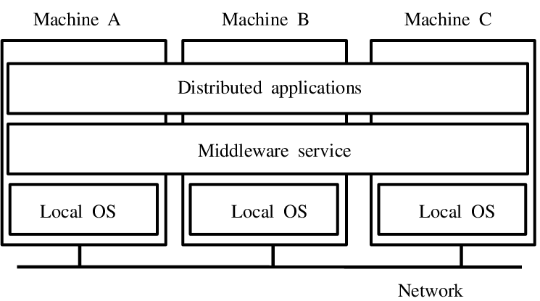
EVOLUTION OF CLOUD COMPUTING
Distributed Systems:
In distributed cloud computing, a single task is spread across multiple machines in different locations, all interconnected.
Each machine handles a part of the workload, expediting the completion of the task.
Cloud computing facilitates this by granting remote network access to devices and applications, offering advantages like resource sharing, scalability, cost-efficiency, and platform flexibility.
Distributed cloud computing represents a network where numerous computers collaborate to achieve a common goal, with each machine contributing to the overall task.

Slide 19
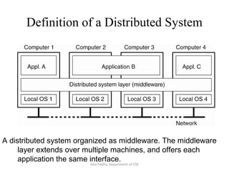
EVOLUTION OF CLOUD COMPUTING
Distributed Systems:
Cloud computing revolves around internet-based access and provision of essential resources, while distributed cloud computing revolves around resource sharing across a network of multiple computers.
Users of distributed cloud computing can access additional functionalities available for purchase, such as data retention capabilities or the ability to set performance benchmarks for latency and throughput.
Service providers are accountable for delivering the infrastructure required for these features.
Primarily targeting the enhancement of commercial operations, distributed cloud computing signifies the future of corporate computing.

Slide 20
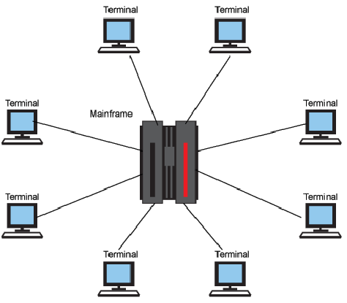
EVOLUTION OF CLOUD COMPUTING
Mainframe Computing :
Initially introduced in 1951, mainframe computers stand as robust and reliable computing machinery.
The term "mainframe" has evolved from denoting the central housing or frame encompassing the computer's central processing unit (CPU). During their inception, computers were as large as garages, with the CPU frame possibly equating to the size of a walk-in closet.
However, presently, "mainframe" refers to a substantial computer system overseeing an entire organization.

Slide 21
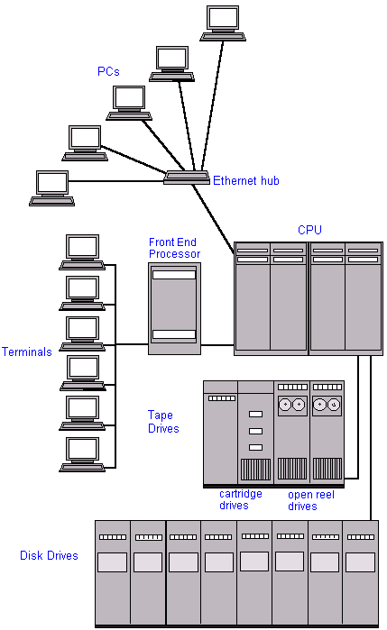
EVOLUTION OF CLOUD COMPUTING
Mainframe Computing :
While the term “huge” might encompass anything of room-sized proportions, contemporary “mainframes” are considerably smaller, although still significantly larger than personal computers or even minicomputers.
A mainframe boasts extensive storage capacity via disk and tape (measured in gigabytes, amounting to thousands of kilobytes) alongside substantial main memory.

Slide 22
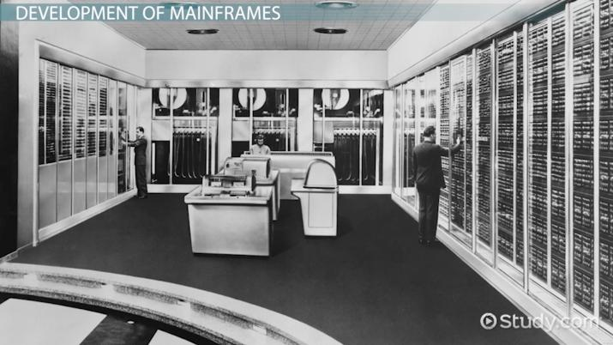
EVOLUTION OF CLOUD COMPUTING
Mainframe Computing :
Theoretically, its processing speed surpasses that of the fastest personal computer.
However, acquiring a mainframe incurs significant costs, typically commencing at approximately $500,000 and ascending from there.
In today's landscape, where business operations, transactions, and communication occur in real-time, robust servers are imperative to swiftly execute instructions and generate output.

Slide 23
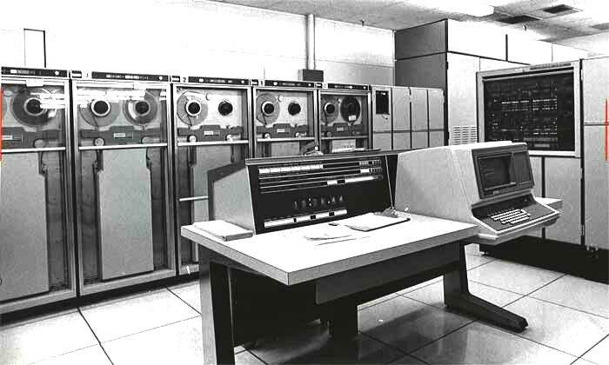
EVOLUTION OF CLOUD COMPUTING
Mainframe Computing :
Computers are categorized into four types based on their contemporary applications: supercomputers, mainframe computers, minicomputers, and microcomputers.
Following supercomputers, mainframe computers stand as the swiftest option for complex and extensive computations.
They surpass the power of minicomputers or microcomputers but fall short in capability compared to supercomputers. Mainframe computers find extensive utilization in large corporations.

Slide 24
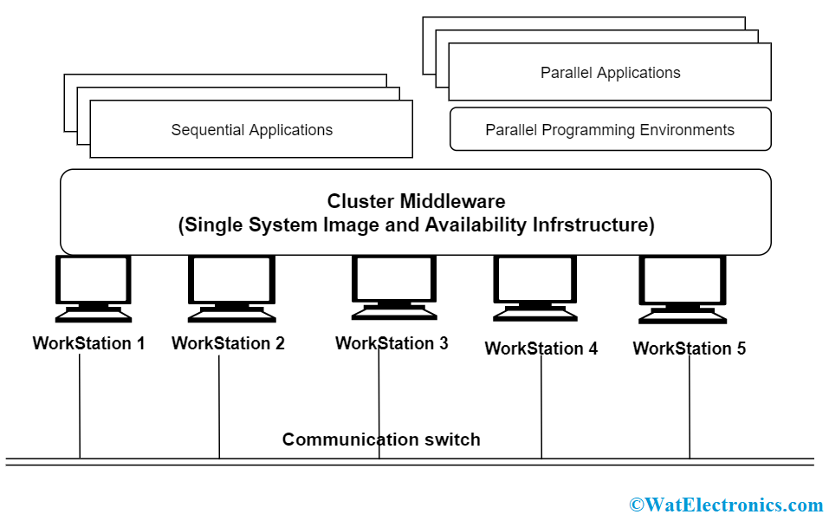
EVOLUTION OF CLOUD COMPUTING
Cluster Computing:
Cluster computing involves harnessing multiple interconnected computers within a network to operate collectively as a unified entity.
Each computer integrated into this network is termed a node.
This approach tackles intricate problems by enhancing processing speed and ensuring data integrity.

Slide 25
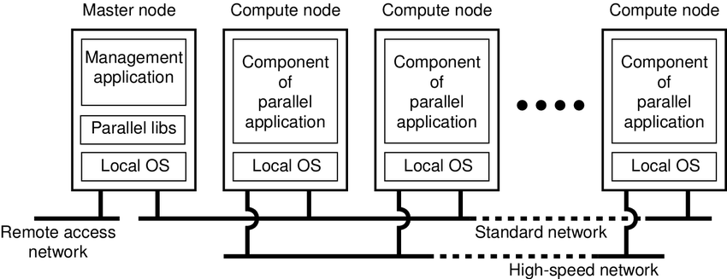
EVOLUTION OF CLOUD COMPUTING
Cluster Computing:
Through simultaneous operations across the connected computers, a unified system (referred to as a virtual machine) is simulated, known as system transparency.
This networking model is built on the concept of distributed systems, with Local Area Networks (LANs) serving as the connecting framework.

Slide 26
EVOLUTION OF CLOUD COMPUTING
Cluster Computing:
Key features of cluster computing include:
Uniformity in the equipment of linked computers.
Tight interconnection facilitated by specialized network connections.
Every computer sharing an identical home directory.
The hardware configuration of clusters varies based on the networking protocols employed.
Clusters are categorized as open or closed systems.
Open clusters necessitate IP addresses and are accessible solely via the internet, raising potential security concerns.
In Closed Clustering, the nodes are hidden behind the gateway node, providing better security.

Slide 27
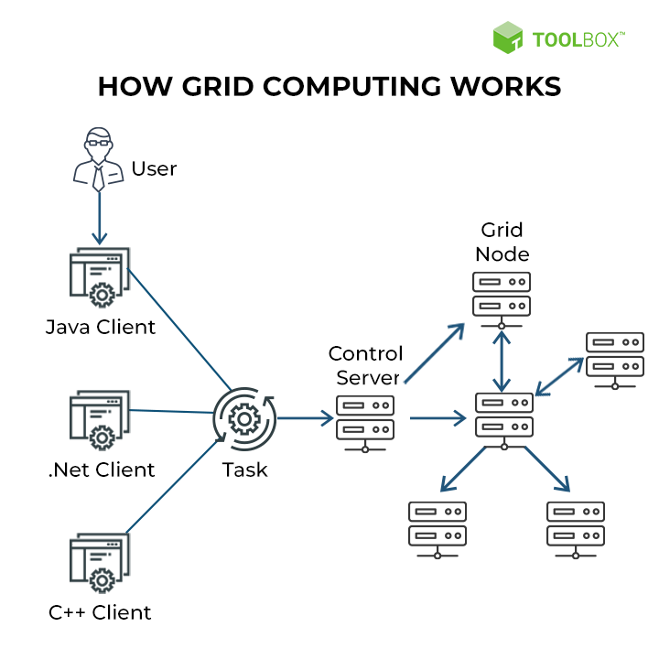
EVOLUTION OF CLOUD COMPUTING
Grid Computing:
Grid computing emerged as a progression in the realm of cloud computing, making its debut in the 1990s.
It stands as a computing framework that consolidates computing resources spanning diverse geographical locations to accomplish shared objectives.
By amalgamating and granting access to unused resources from multiple computers, grid computing facilitates the execution of singular tasks.

Slide 28
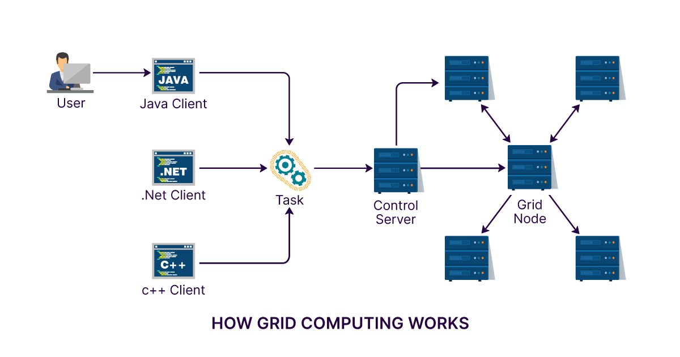
EVOLUTION OF CLOUD COMPUTING
Grid Computing:
Businesses leverage grid computing to tackle extensive operations or address intricate challenges that surpass the capabilities of a single computer.
For instance, meteorologists harness grid computing for weather modeling, a computationally demanding field necessitating intricate data management and analysis.
The sheer volume of weather data poses inefficiencies when processed on a single computer, leading meteorologists to distribute the analysis across geographically dispersed grid computing systems and subsequently merge the findings.

Slide 29
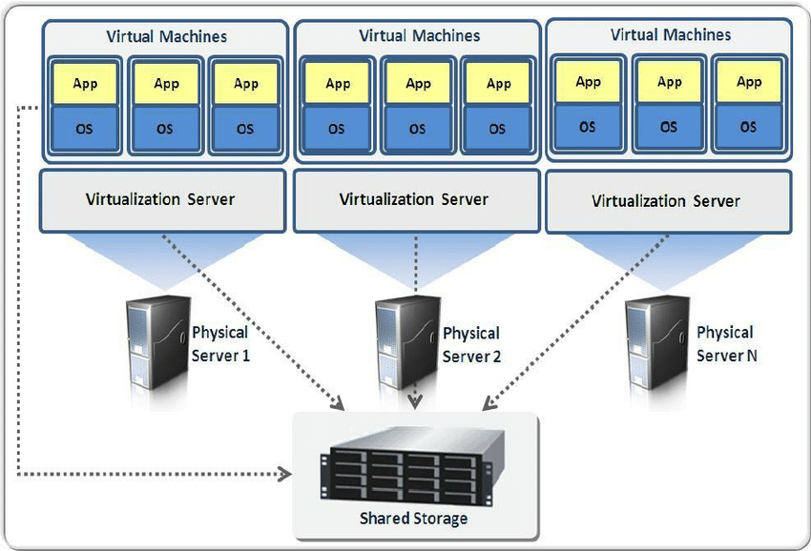
EVOLUTION OF CLOUD COMPUTING
Virtualization:
Around four decades ago, virtualization made its initial appearance.
This technology harnesses software to craft an abstraction layer atop computer hardware, partitioning the physical elements of a single computer—such as processors, memory, and storage—into multiple virtual computers, commonly referred to as virtual machines (VMs).
Each VM operates with its own distinct operating system (OS) and functions akin to an independent computer, albeit utilizing only a fraction of the underlying hardware resources.

Slide 30
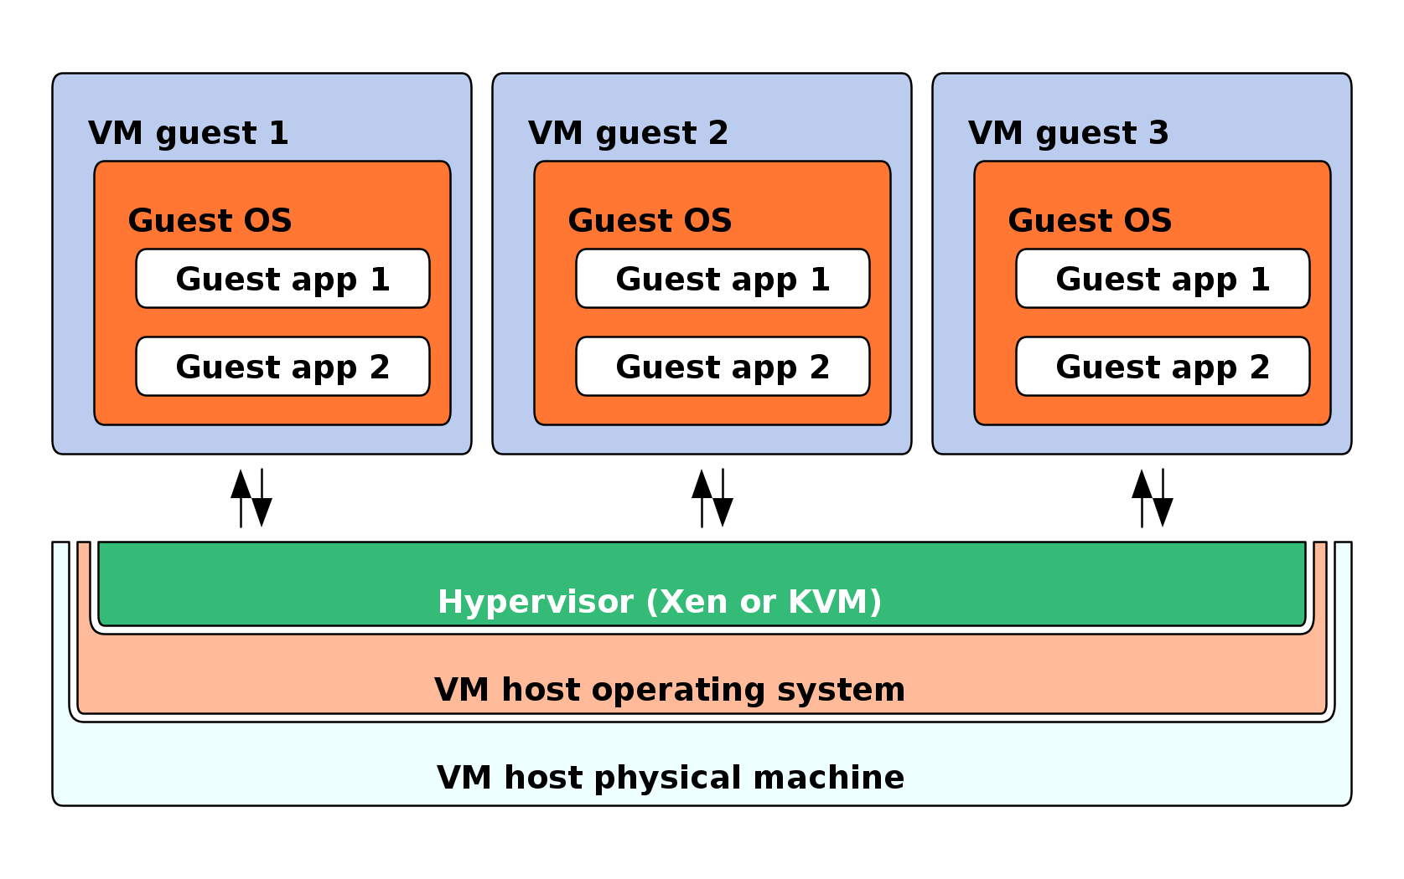
EVOLUTION OF CLOUD COMPUTING
Virtualization:
This approach results in enhanced efficiency in utilizing physical computer systems and offers a heightened return on investment in an organization's hardware.
Virtualization has evolved into a pivotal technique within business IT architecture, serving as the driving force behind the economics of cloud computing.
It empowers cloud providers to cater to customers utilizing their existing physical computer infrastructure.

Slide 31
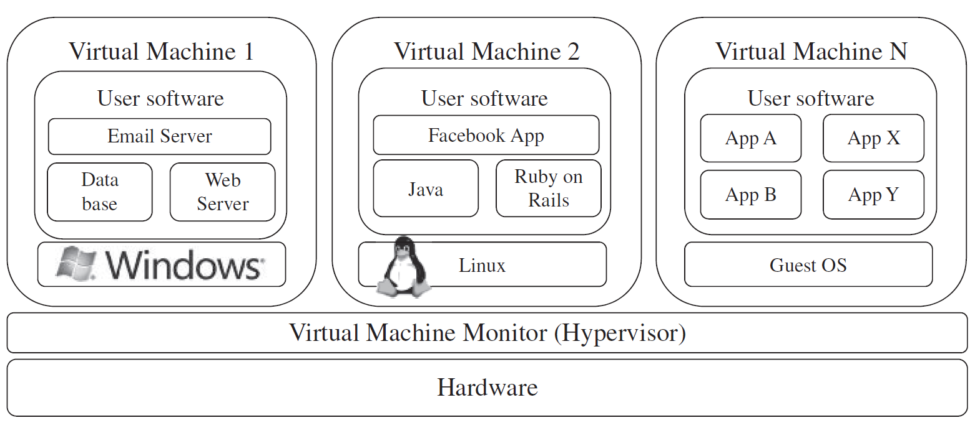
EVOLUTION OF CLOUD COMPUTING
Virtualization:
For cloud users, virtualization enables the purchase of specific computing resources as needed, facilitating cost-effective scalability as their workload demands expand.

Slide 32
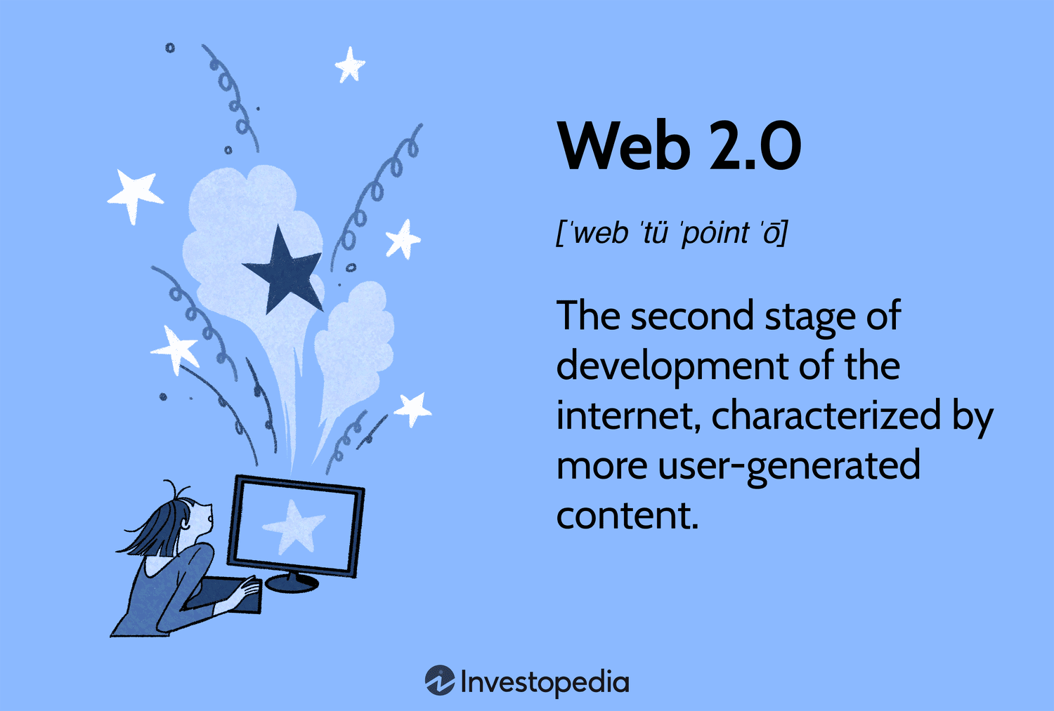
EVOLUTION OF CLOUD COMPUTING
Web 2.0:
It is the interface through which the cloud computing services interact with the clients.
It is because of Web 2.0 that we have interactive and dynamic web pages.
It also increases flexibility among web pages.
Popular examples of web 2.0 include Google Maps, Facebook, Twitter, etc.
In gained major popularity in 2004.

Slide 33
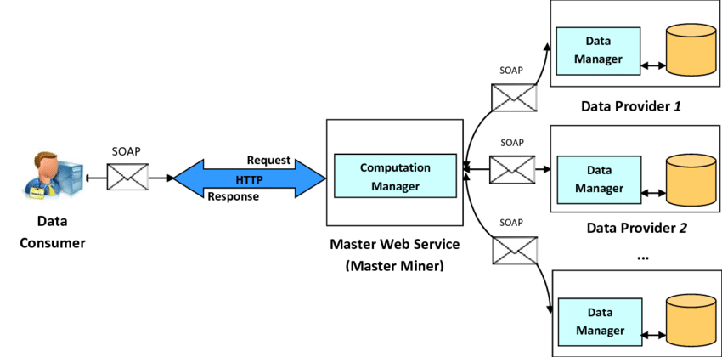
EVOLUTION OF CLOUD COMPUTING
Service Oriented Architecture:
The evolution of application development and integration has reached a milestone referred to as service-oriented architecture (SOA), delineating the utilization of interfaces to enhance the reusability of software components.
In essence, SOA represents an architectural approach facilitating programming to leverage network services.
Applications within this framework access services through internet-based network calls, streamlining service integrations through widely adopted communication protocols.

Slide 34
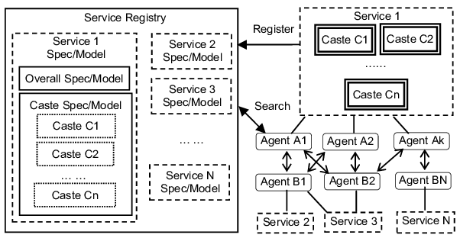
EVOLUTION OF CLOUD COMPUTING
Service Oriented Architecture:
In the realm of SOA, each service represents a comprehensive business function, easily integrable into applications by developers.
It's important to note that SOA and microservice architecture differ significantly.
SOA enables users to create applications by amalgamating various features from existing services.
These principles, forming the foundation of SOA, guide system development and enable the assembly of components into a cohesive, decentralized system.
Functionalities are encapsulated within an array of interoperable services through SOA-based computing, empowering their incorporation into diverse software programs spanning multiple business domains.

Slide 35
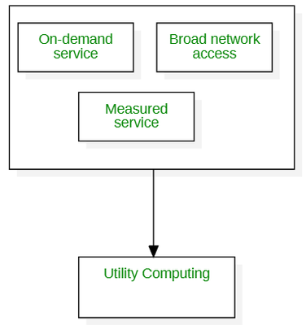
EVOLUTION OF CLOUD COMPUTING
Utility Computing:
Utility computing refers to a service model in cloud computing that offers clients access to computing resources on-demand, similar to traditional utility services like electricity or water.

Slide 36
EVOLUTION OF CLOUD COMPUTING
Utility Computing:
Following are its key aspects:
• On-Demand Resource Access: Utility computing provides users with immediate access to computing resources, including hardware, software, storage, and networking, as required. Users can scale up or down their resources based on real-time needs.
• Pay-Per-Use Model: Instead of fixed fees or flat rates, users are charged based on their actual usage of resources. This pay-as-you-go or pay-per-use model ensures cost-effectiveness, as users only pay for what they consume.
• Scalability and Flexibility: Utility computing offers high scalability, allowing users to increase or decrease resources rapidly to accommodate changing workloads or demands. This flexibility is crucial for businesses experiencing fluctuating computing needs.
• Resource Pooling: Providers of utility computing pool computing resources from multiple clients, optimizing resource utilization. This shared infrastructure model ensures efficient use of resources and cost savings for users.

Slide 37
EVOLUTION OF CLOUD COMPUTING
Utility Computing:
Following are its key aspects:
• Ease of Access and Management: Users can access computing resources through the internet, making them accessible from anywhere. Additionally, management of these resources, such as provisioning or deprovisioning, can be handled remotely and efficiently.
• Service Variety: Utility computing encompasses various services, including Infrastructure as a Service (IaaS), Platform as a Service (PaaS), and Software as a Service (SaaS). These services cater to different user needs, from raw computing power (IaaS) to complete software solutions (SaaS).
• Business Benefits: For businesses, utility computing offers reduced upfront capital expenditures by eliminating the need to purchase and maintain dedicated hardware. It also allows for more efficient resource allocation, as companies can adjust resources based on current demand.
• Reliability and Availability: Utility computing services often boast high reliability and availability due to redundant infrastructure and advanced data centers. This ensures minimal downtime and uninterrupted access to resources.

Slide 38
CHARACTERISTICS OF CLOUD COMPUTING
Cloud computing is characterized by several key features:
On-Demand Self-Service: Users can independently provision and manage computing resources, such as storage, processing power, and applications, without requiring human intervention from the service provider.
Broad Network Access: Cloud services are accessible over the internet from various devices like laptops, smartphones, and tablets, allowing ubiquitous access to resources and applications.
Resource Pooling: Cloud computing providers consolidate computing resources to serve multiple users, dynamically allocating and reallocating resources as needed. This pooling enables cost efficiency and optimization of resources.
Rapid Elasticity: Cloud services provide scalability, allowing users to swiftly scale up or down their resources based on demand. This elasticity ensures that resources can be increased or decreased in a near-instantaneous manner.

Slide 39
CHARACTERISTICS OF CLOUD COMPUTING
Cloud computing is characterized by several key features:
Measured Service: Cloud computing resources are metered and tracked, allowing for usage monitoring, control, and billing based on consumption. This pay-per-use model enhances cost-effectiveness and transparency in resource utilization.
Service Models: Cloud computing offers various service models:
Infrastructure as a Service (IaaS): Provides virtualized computing resources over the internet.
Platform as a Service (PaaS): Offers platforms allowing developers to build, deploy, and manage applications.
Software as a Service (SaaS): Delivers software applications over the internet, eliminating the need for local installation and maintenance.
Deployment Models: Cloud services can be deployed in different ways:
Public Cloud: Services are available to the general public over the internet.
Private Cloud: Resources are dedicated to a single organization and managed either internally or by a third-party provider.
Hybrid Cloud: Combines elements of both public and private clouds, allowing data and applications to be shared between them.

Slide 40
BENEFITS OF CLOUD COMPUTING
Following are the benefits of cloud computing:
• Accessibility Anywhere, Anytime: Access is enhanced across various branches or offices globally, empowering employees, clients, and customers to access up-to-date information from any location or device.
• Reduced Hardware and Software Dependencies: Cloud computing eliminates the need for individual servers, cables, and other hardware, allowing cloud providers to manage these resources for a regular fee, thereby reducing overall expenses significantly.
• Centralized Data Security: Cloud providers handle data backups in their data centers, mitigating the risk of data loss due to individual backups failing. Security technologies like encryption and authentication bolster data privacy.
• Improved Performance and Reliability: Cloud resources enable simultaneous usage, enhancing performance significantly, while the distributed nature of cloud services ensures high availability and negligible downtime. Cloud computing increases input/output operations per second (IOPS).

Slide 41
BENEFITS OF CLOUD COMPUTING
Following are the benefits of cloud computing :
• Swift Application Deployment: Cloud applications can be rapidly deployed without the need for additional hardware, meeting unpredictable business demands efficiently.
• Instant Access to Insights: Cloud platforms facilitate immediate access to data, enabling better decision-making and predictive analysis based on historical data.
• Business Continuity: Cloud services ensure continuity in case of disasters, utilizing vast data storage and remote activation systems to maintain business operations.
• Cost Savings and Price-Performance: Despite initial investment, long-term savings result from reduced hardware maintenance costs and the ability to test cloud systems before investment. Flexible pricing models like those offered by Oracle provide cost-efficiency and performance.
• Virtualized Computing: Cloud resources can be instantly allocated to meet increased demand, enabling seamless scalability without downtime or additional infrastructure.

Slide 42
CLOUD COMPUTING APPLICATIONS
Cloud computing has permeated numerous industries, revolutionizing how businesses and individuals operate. In the realm of business, it facilitates scalable and cost-effective solutions, enabling companies to streamline operations through Software as a Service (SaaS) applications like customer relationship management (CRM), enterprise resource planning (ERP), and office productivity tools.
E-commerce platforms leverage cloud infrastructure for flexible and resilient hosting, ensuring seamless user experiences during peak traffic.
Cloud-based storage and collaboration tools empower remote teams across diverse sectors, from education to healthcare, fostering seamless communication and information sharing.

Slide 43
CLOUD COMPUTING APPLICATIONS
In the realm of data analytics and artificial intelligence, cloud resources support complex computations and large-scale data processing, accelerating innovation and insights.
Moreover, in entertainment and media, streaming services utilize cloud technology to deliver content to global audiences.
The versatility of cloud computing extends to scientific research, facilitating simulations, data sharing, and collaborative projects across borders.
Its applications span industries, driving efficiency, innovation, and accessibility across the digital landscape.

Slide 44
CLOUD COMPUTING APPLICATIONS
Online Data Storage:
Cloud computing allows storing data like files, images, audios, and videos, etc on the cloud storage. The organization need not set physical storage systems to store a huge volume of business data which costs so high nowadays. As they are growing technologically, data generation is also growing with respect to time, and storing that becoming problem. In that situation, Cloud storage is providing this service to store and access data any time as per requirement.
Backup and Recovery :
Cloud vendors provide security from their side by storing safe to the data as well as providing a backup facility to the data. They offer various recovery applications for retrieving the lost data. In the traditional way backup of data is a very complex problem and also it is very difficult sometimes impossible to recover the lost data. But cloud computing has made backup and recovery applications very easy where there is no fear of running out of backup media or loss of data.
Big Data Analysis:
We know the volume of big data is so high where storing that in traditional data management system for an organization is impossible. But cloud computing has resolved that problem by allowing the organizations to store their large volume of data in cloud storage without worrying about physical storage. Next comes analyzing the raw data and finding out insights or useful information from it is a big challenge as it requires high-quality tools for data analytics. Cloud computing provides the biggest facility to organizations in terms of storing and analyzing big data.

Slide 45
CLOUD COMPUTING APPLICATIONS
eCommerce Application:
Cloud-based e-commerce allows responding quickly to the opportunities which are emerging. Users respond quickly to the market opportunities as well as the traditional e-commerce responds to the challenges quickly. Cloud-based e-commerce gives a new approach to doing business with the minimum amount as well as minimum time possible. Customer data, product data, and other operational systems are managed in cloud environments.
Cloud Computing in Education :
Cloud computing in the education sector brings an unbelievable change in learning by providing e-learning, online distance learning platforms, and student information portals to the students. It is a new trend in education that provides an attractive environment for learning, teaching, experimenting, etc to students, faculty members, and researchers. Everyone associated with the field can connect to the cloud of their organization and access data and information from there.

Slide 46
CLOUD COMPUTING APPLICATIONS
eGovernance Application:
Cloud computing can provide its services to multiple activities conducted by the government. It can support the government to move from the traditional ways of management and service providers to an advanced way of everything by expanding the availability of the environment, making the environment more scalable and customized. It can help the government to reduce the unnecessary cost in managing, installing, and upgrading applications and doing all these with help of could computing and utilizing that money public service.
Health Care:
In the medical field also nowadays cloud computing is used for storing and accessing the data as it allows to store data and access it through the internet without worrying about any physical setup. It facilitates easier access and distribution of information among the various medical professional and the individual patients. Similarly, with help of cloud computing offsite buildings and treatment facilities like labs, doctors making emergency house calls and ambulances information, etc can be easily accessed and updated remotely instead of having to wait until they can access a hospital computer.
Entertainment Applications:
Many people get entertainment from the internet, in that case, cloud computing is the perfect place for reaching to a varied consumer base. Therefore different types of entertainment industries reach near the target audience by adopting a multi-cloud strategy. Cloud-based entertainment provides various entertainment applications such as online music/video, online games and video conferencing, streaming services, etc and it can reach any device be it TV, mobile, set-top box, or any other form. It is a new form of entertainment called On-Demand Entertainment (ODE).

Slide 47
CLOUD COMPUTING APPLICATIONS
Social Media Networks:
Cloud computing plays a pivotal role in social media platforms, powering their scalability, accessibility, and real-time interactions. These platforms handle enormous volumes of data generated by users worldwide, and cloud infrastructure allows them to store, process, and manage this data efficiently. Through cloud-based services, social media companies can dynamically scale their resources based on fluctuating user demands, ensuring seamless performance even during traffic spikes, events, or viral content. Additionally, cloud computing enables the rapid deployment of new features and updates, fostering continuous innovation and user engagement. Collaborative tools and content sharing on social media heavily rely on cloud storage and computing, allowing users to upload, share, and access multimedia content from any device, anywhere. The elastic nature of cloud computing empowers social media platforms to adapt swiftly to evolving user needs, maintain data security, and deliver a seamless, personalized user experience on a global scale.

Slide 48
CHALLENGES OF CLOUD COMPUTING
The cloud stands as a pivotal resource offering diverse advantages, yet it also poses numerous risks and hurdles. This article delves into prevalent challenges encountered in cloud computing, encompassing security concerns, common issues, and established solutions within the industry.
Data Security and Privacy: When working with Cloud environments, data security is a major concern as users have to take responsibility for their data, and not all Cloud providers can assure 100% data privacy. No identity access management, lack of visibility and control tools, data misuse, and cloud misconfiguration are the common reasons behind cloud privacy leaks. There are also concerns about malicious insiders, insecure APIs, and neglect or oversights in cloud data management.
Multi-Cloud Environments: Operating within multi-cloud environments introduces various issues and hurdles, including configuration mistakes, data governance complexities, security patch deficiencies, and granularity limitations. Implementing consistent data management policies across diverse platforms while monitoring the security requisites across multiple clouds proves challenging.
Performance Challenges: The reliability and security of cloud computing solutions hinge on the vendors. It's important to note that if a cloud vendor experiences downtime, there's a risk of potential data loss.
Interoperability and Flexibility: When attempting to move applications across different cloud environments, achieving interoperability becomes a challenge.

Slide 49
CHALLENGES OF CLOUD COMPUTING
High Dependence on Network: When transferring large volumes of information between Cloud data servers, a lack of sufficient internet bandwidth is a common problem. There is a risk of sudden outages, and data is highly vulnerable. To help prevent business losses from sudden outages, enterprises should ensure there is high bandwidth without sacrificing performance.
Lack of Knowledge and Expertise: Finding the appropriate Cloud talent stands as a prevalent challenge in cloud computing. The industry faces a scarcity of qualified security professionals, creating a demand-supply gap. With escalating workloads and a surge in tool launches, enterprises require adept expertise to effectively leverage these tools and determine the most suitable options.
Reliability and Availability: High unavailability of Cloud services, as well as lack of reliability are the major concerns in these ecosystems. In order to keep up with ever-changing business requirements, businesses are forced to seek additional computing resources. If a Cloud vendor gets hacked, the sensitive data of organizations using their services gets compromised.

Slide 50
CHALLENGES OF CLOUD COMPUTING
Password Security: Account managers manage all their cloud accounts using the same passwords. Password management poses a critical problem, and it is often found that users resort to using weak and reused passwords.
Cost Management: Although Cloud Service Providers (CSPs) offer a pay-as-you-go subscription model for services, hidden costs are charged as underutilized resources in enterprises, making the costs can add up.
Governance: Good IT governance makes sure that the right tools are used and assets get implemented as per procedures and agreed-on policies. Lack of governance is a common problem in cloud computing, and companies utilize tools that do not align with their vision. IT teams don’t get total control of compliance, data quality checks, and risk management, thus creating many uncertainties when migrating to the cloud from traditional infrastructures.
Compliance: When it comes to having the best data compliance policies, cloud Service Providers (CSP) are not up-to-date. Organizations run into compliance issues with state laws and regulations whenever a user transfers data from internal servers to the cloud.

Slide 51
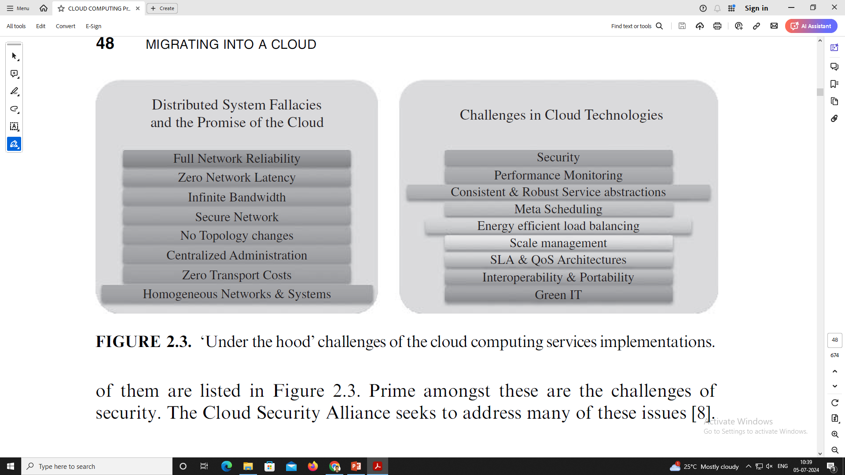
CHALLENGES OF CLOUD COMPUTING

